Slide 1


NISR
HACKATHON
Aksumite-Toumai
December 1, 2023

Slide 2
Aksumite-Toumai
Team Members
Luel Hagos Beyene
Abdelwahab Mahamat Azibert
University - African Institute for Mathematical Sciences (AIMS)

Slide 3
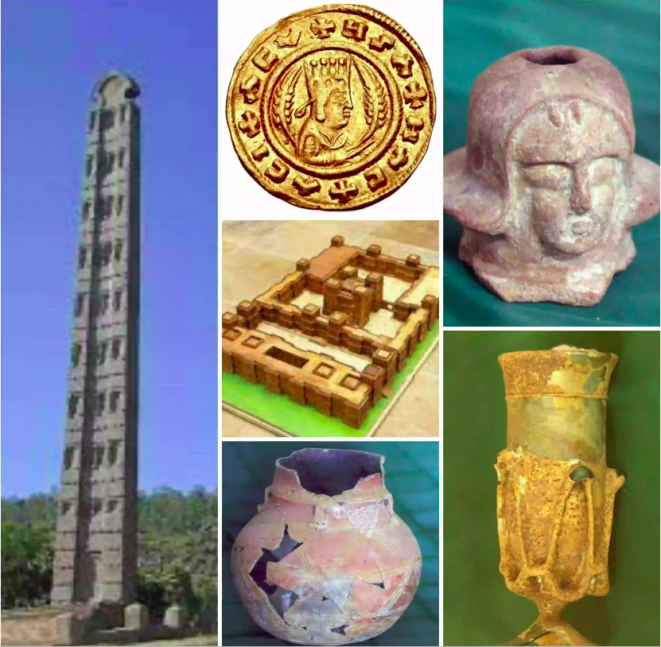
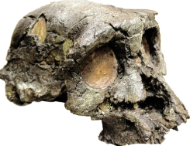
Aksumite-Toumai
Team name - Aksumite-Toumai

Slide 4
Hackathon Objectives
Innovative Data Representation
Skill Development
Enhancing Data Literacy
Encouraging Creativity in Data Utilization

Slide 5


Our Project
Dataset
GDP
CPI
Image source - link
Image source - link

Slide 6
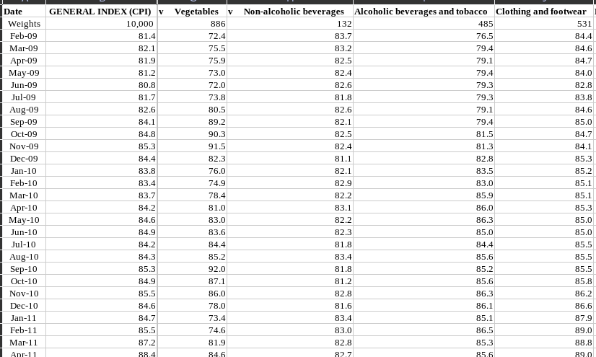
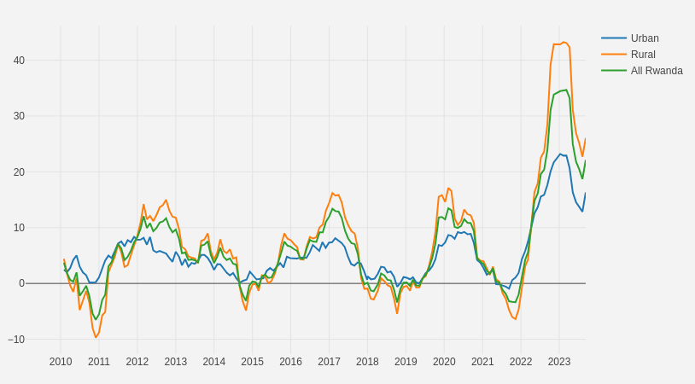
Our Project
Transform Data into Insights

Slide 7
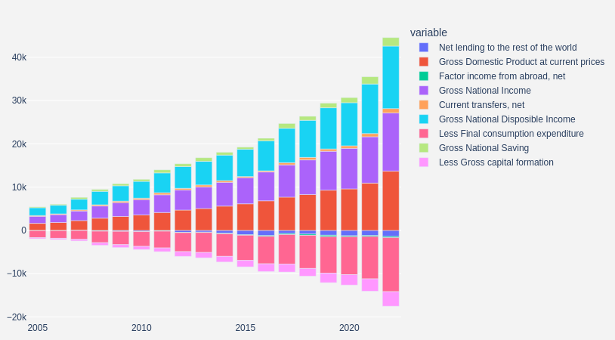
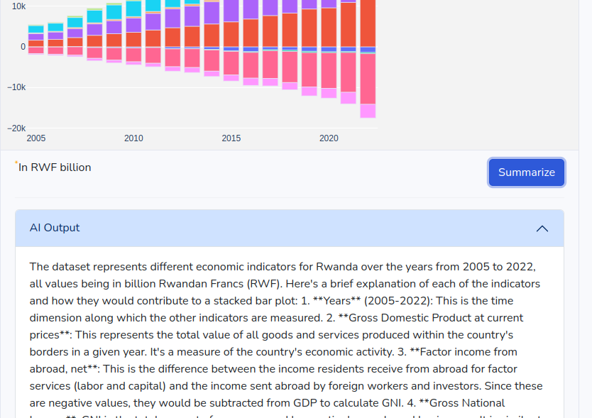

Our Project
Innovation and Creativity
AI

Slide 8
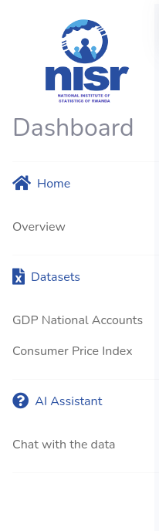
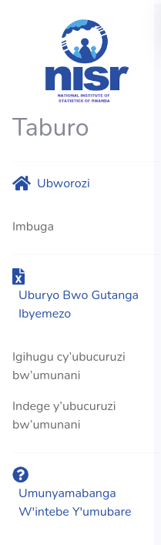
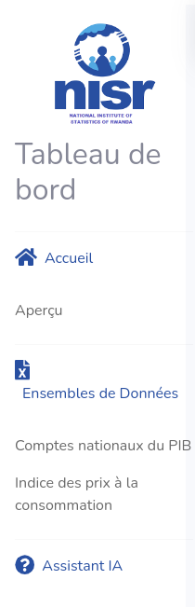



Our Project
Innovation and Creativity

Slide 9

Our Project
Collaboration
Image source - link

Slide 10

Our Project
Educational Impact
Image source - link

Slide 11
Our process (Steps)
Data Acquisition & Preprocessing
Exploratory Data Analysis (EDA)
Design & Development
Testing & Iteration
Finalization & Presentation

Slide 12
Tools and Technologies
Python
Flask
Bootstrap
Dash
Plotly
LLMs (Large Language Models)
Pandas

Slide 13
Future Work
Generate reports using a specific template with Large Language Models.
Include language translation features.
Incorporate an AI-assisted chatbot to enable users to interact with the dataset and graphs conversationally.

Slide 14
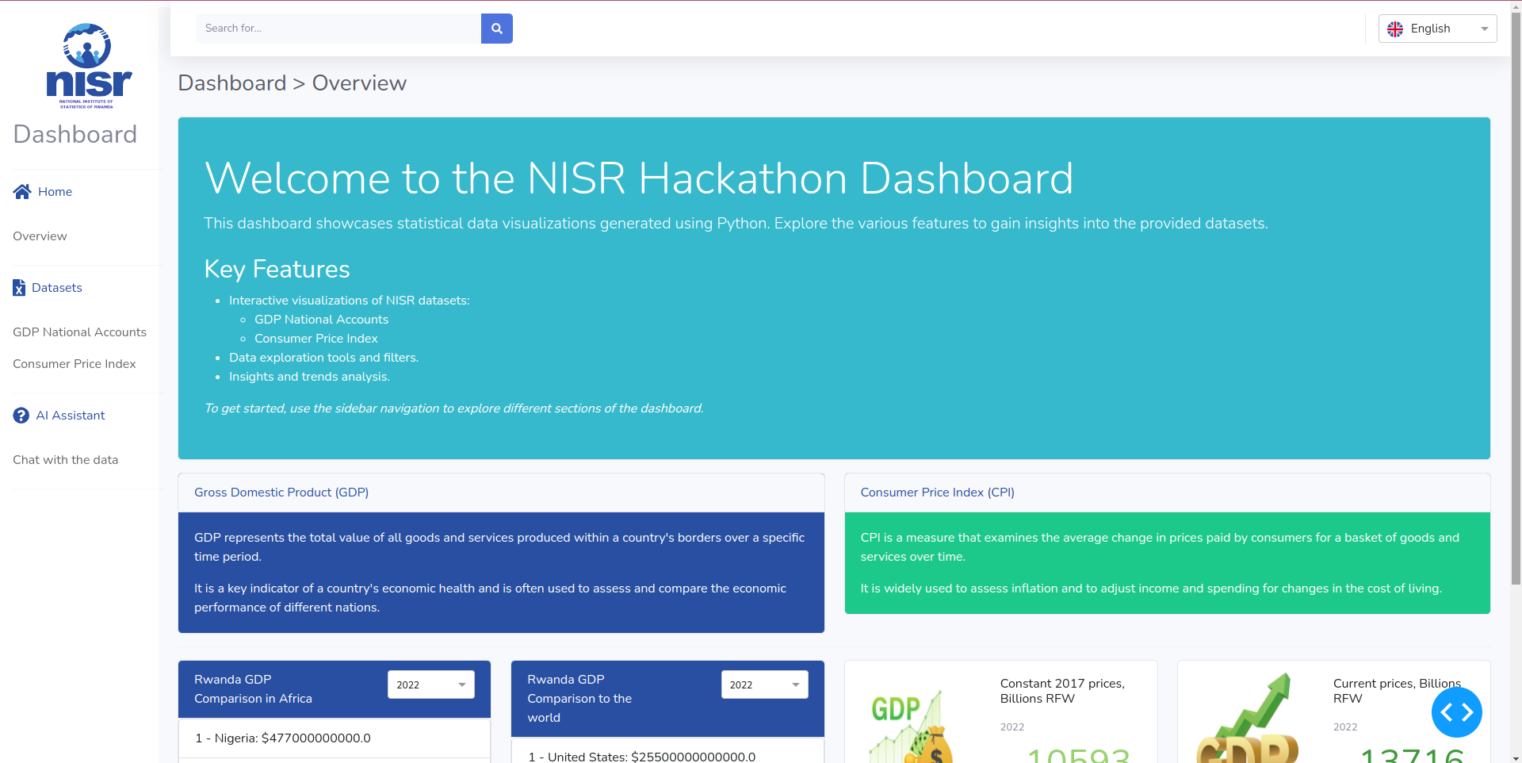
Dashboard Demo

Slide 15
Questions?
Questions?

Slide 16
Thank you
Murakoze!

